Slide 1
Chapter 2: LAN Redundancy
Scaling Networks
Notes:
Cisco Networking Academy program
Switched Networks
Chapter 2: LAN Redundancy

Slide 2
Chapter 2
2.0 Introduction
2.1 Spanning Tree Concepts
2.2 Varieties of Spanning Tree Protocols
2.3 Spanning Tree Configuration
2.4 First-Hop Redundancy Protocols
2.5 Summary
Notes:
Chapter 2

Slide 3
Chapter 2: Objectives
Describe the issues with implementing a redundant network.
Describe IEEE 802.1D STP operation.
Describe the different spanning tree varieties.
Describe PVST+ operation in a switched LAN environment.
Describe Rapid PVST+ operation in a switched LAN environment.
Configure PVST+ in a switched LAN environment.
Configure Rapid PVST+ in a switched LAN environment.
Identify common STP configuration issues.
Describe the purpose and operation of first hop redundancy protocols.
Describe the different varieties of first hop redundancy protocols.
Use Cisco IOS commands to verify HSRP and GLBP implementations.
Notes:
Chapter 2 Objectives

Slide 4
2.1 Spanning Tree Concepts
Notes:
2.1 Spanning Tree Concepts

Slide 5
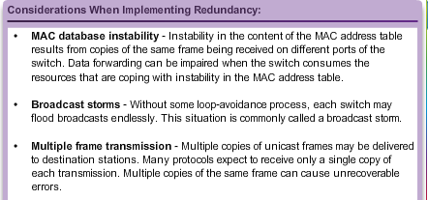
Purpose of Spanning Tree Redundancy at OSI Layers 1 and 2
Multiple cabled paths between switches:
Provide physical redundancy in a switched network.
Improves the reliability and availability of the network.
Enables users to access network resources, despite path disruption.
Notes:
2.1.1.1 Redundancy of OSI Layers 1 and 2

Slide 6
Purpose of Spanning Tree Issues with Layer 1 Redundancy: MAC Database Instability
Ethernet frames do not have a time to live (TTL) attribute.
Frames continue to propagate between switches endlessly, or until a link is disrupted and breaks the loop.
Results in MAC database instability.
Can occur due to broadcast frames forwarding.
If there is more than one path for the frame to be forwarded out, an endless loop can result.
When a loop occurs, it is possible for the MAC address table on a switch to constantly change with the updates from the broadcast frames, resulting in MAC database instability.
Notes:
2.1.1.2 Issues with Layer 1 Redundancy: MAC Database Instability

Slide 7
Purpose of Spanning Tree Issues with Layer 1 Redundancy: Broadcast Storms
A broadcast storm occurs when there are so many broadcast frames caught in a Layer 2 loop that all available bandwidth is consumed. It is also known as denial of service
A broadcast storm is inevitable on a looped network.
As more devices send broadcasts over the network, more traffic is caught within the loop; thus consuming more resources.
This eventually creates a broadcast storm that causes the network to fail.
Notes:
2.1.1.3 Issues with Layer 1 Redundancy: Broadcast Storms

Slide 8
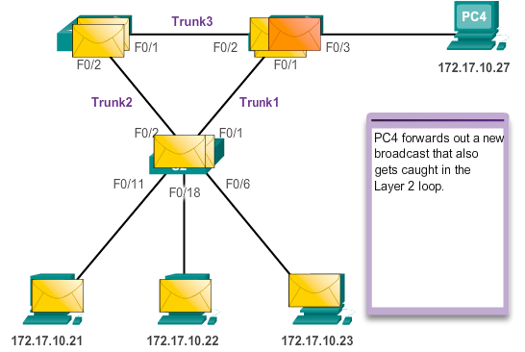
Purpose of Spanning Tree Issues with Layer 1 Redundancy: Broadcast Storms
Notes:
2.1.1.3 Issues with Layer 1 Redundancy: Broadcast Storms (cont.)

Slide 9
Purpose of Spanning Tree Issues with Layer 1 Redundancy: Duplicate Unicast Frames
Unicast frames sent onto a looped network can result in duplicate frames arriving at the destination device.
Most upper layer protocols are not designed to recognize, or cope with, duplicate transmissions.
Layer 2 LAN protocols, such as Ethernet, lack a mechanism to recognize and eliminate endlessly looping frames.
Notes:
2.1.1.4 Issues with Layer 1 Redundancy: Duplicate Unicast Frames

Slide 10
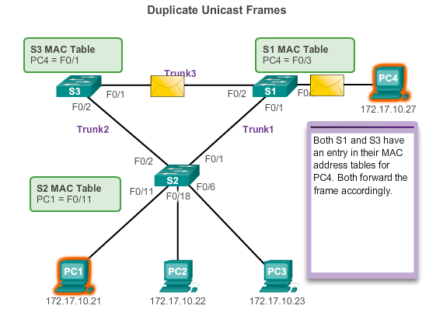
Purpose of Spanning Tree Issues with Layer 1 Redundancy: Duplicate Unicast Frames
Notes:
2.1.1.4 Issues with Layer 1 Redundancy: Duplicate Unicast Frames (cont.)

Slide 11
STP Operation Spanning Tree Algorithm: Introduction
STP ensures that there is only one logical path between all destinations on the network by intentionally blocking redundant paths that could cause a loop.
A port is considered blocked when user data is prevented from entering or leaving that port. This does not include bridge protocol data unit (BPDU) frames that are used by STP to prevent loops.
The physical paths still exist to provide redundancy, but these paths are disabled to prevent the loops from occurring.
If the path is ever needed to compensate for a network cable or switch failure, STP recalculates the paths and unblocks the necessary ports to allow the redundant path to become active.
Notes:
2.1.2.1 Spanning Tree Algorithm Introduction

Slide 12
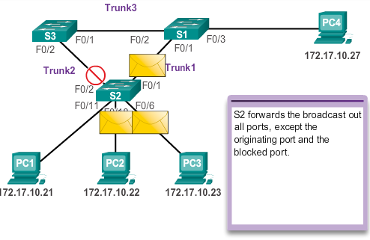
STP Operation Spanning Tree Algorithm: Introduction
Notes:
2.1.2.1 Spanning Tree Algorithm Introduction (cont.)

Slide 13
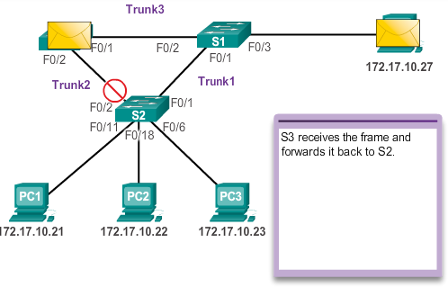
STP Operation Spanning Tree Algorithm: Introduction
Notes:
2.1.2.1 Spanning Tree Algorithm Introduction (cont.)

Slide 14
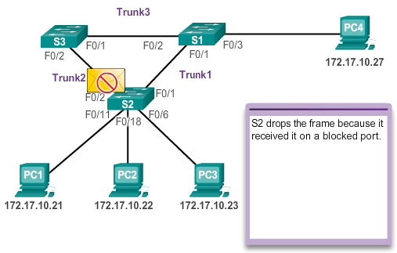
STP Operation Spanning Tree Algorithm: Introduction
Notes:
2.1.2.1 Spanning Tree Algorithm Introduction (cont.)

Slide 15
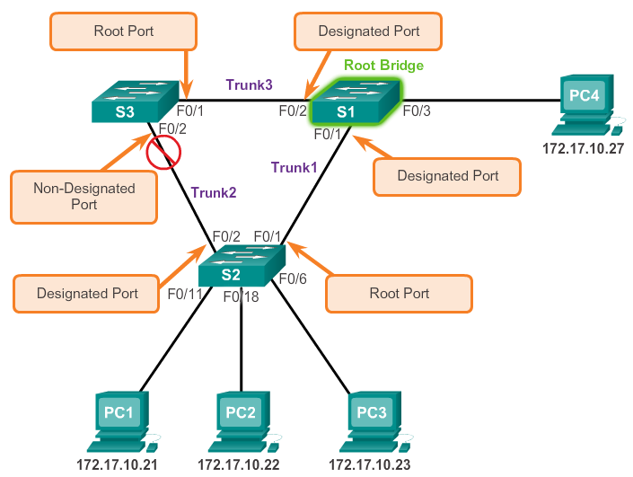
STP Operation Spanning Tree Algorithm: Port Roles
Notes:
2.1.2.2 Spanning Tree Algorithm: Port Roles

Slide 16
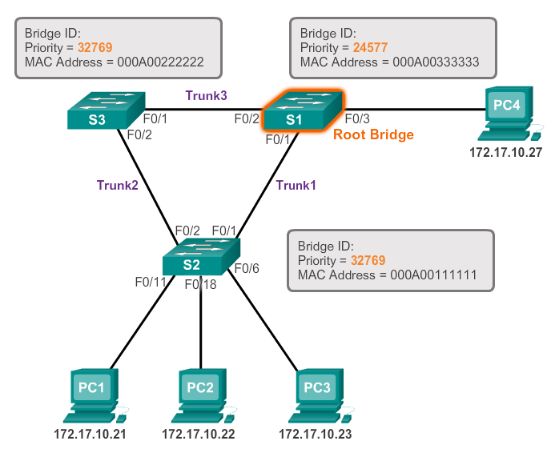
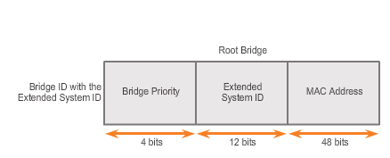
STP Operation Spanning Tree Algorithm: Root Bridge
Notes:
2.1.2.3 Spanning Tree Algorithm: Root Bridge

Slide 17
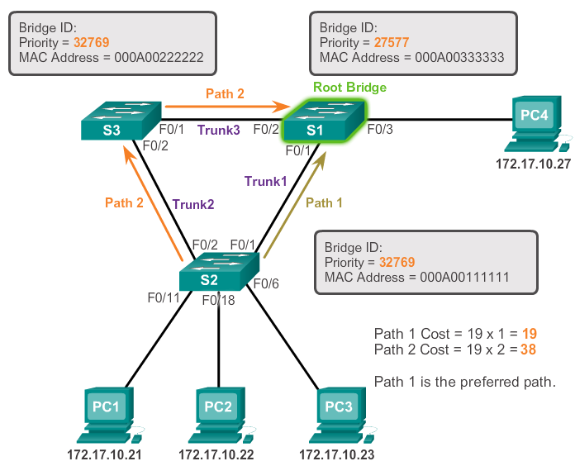
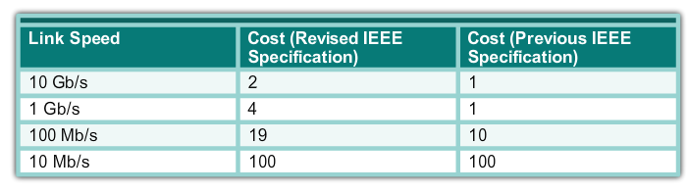
STP Operation Spanning Tree Algorithm: Path Cost
Notes:
2.1.2.4 Spanning Tree Algorithm: Path Cost

Slide 18
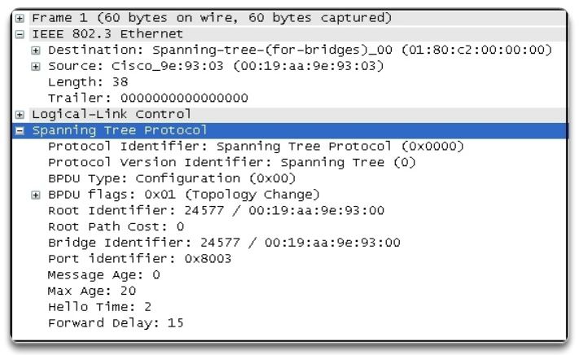
STP Operation 802.1D BPDU Frame Format
Notes:
2.1.2.5 802.1D BPDU Frame Format

Slide 19
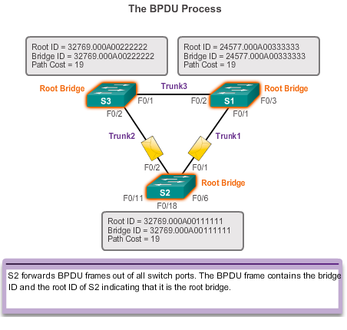
STP Operation BPDU Propagation and Process
Notes:
2.1.2.6 BPDU Propagation and Process

Slide 20
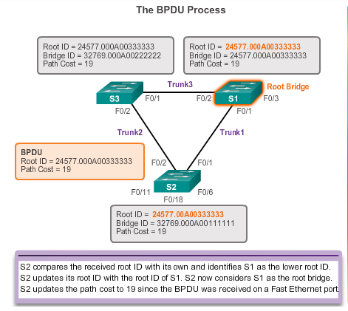
STP Operation BPDU Propagation and Process
Notes:
2.1.2.6 BPDU Propagation and Process

Slide 21
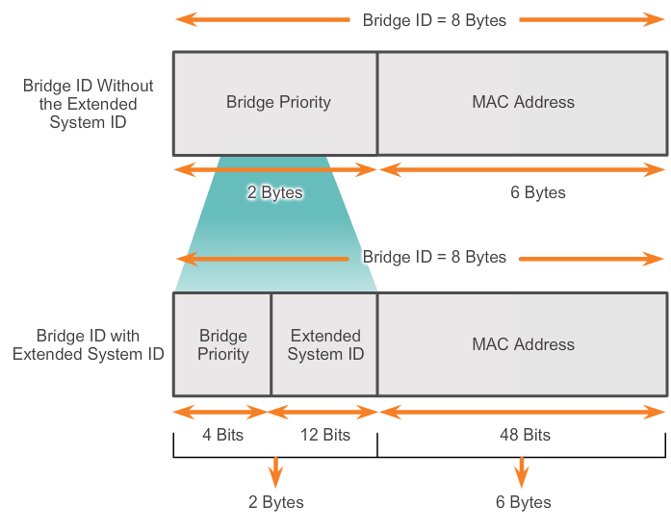
STP Operation Extended System ID
STP was enhanced to include support for VLANs, requiring the VLAN ID to be included in the BPDU frame through the use of the extended system ID
Notes:
2.1.2.7 Extended System ID

Slide 22
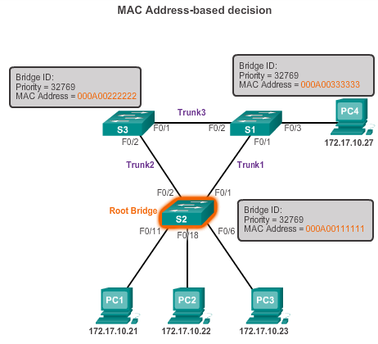
STP Operation Extended System ID
In the example, the priority of all the switches is 32769. The value is based on the 32768 default priority and the VLAN 1 assignment associated with each switch (32768+1).
Notes:
2.1.2.7 Extended System ID

Slide 23
2.2 Varieties of Spanning Tree Protocols
Notes:
2.2 Varieties of Spanning Tree Protocols

Slide 24
Overview List of Spanning Tree Protocols
STP or IEEE 802.1D-1998
PVST+
IEEE 802.1D-2004
Rapid Spanning Tree Protocol (RSTP) or IEEE 802.1w
Rapid PVST+
Multiple Spanning Tree Protocol (MSTP) or IEEE 802.1s
Notes:
2.2.1.1 List of Spanning Tree Protocols

Slide 25
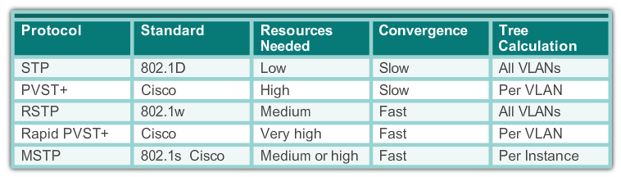
STP Overview Characteristics of the Spanning Tree Protocols
Notes:
2.2.1.2 Characteristics of the Spanning Tree Protocols

Slide 26
PVST+ Overview of PVST+
Networks running PVST+ have these characteristics:
A network can run an independent IEEE 802.1D STP instance for each VLAN in the network.
Optimum load balancing can result.
One spanning-tree instance for each VLAN maintained can mean a considerable waste of CPU cycles for all the switches in the network. In addition to the bandwidth that is used for each instance to send its own BPDU.
Notes:
2.2.2.1Overview of PVST+

Slide 27
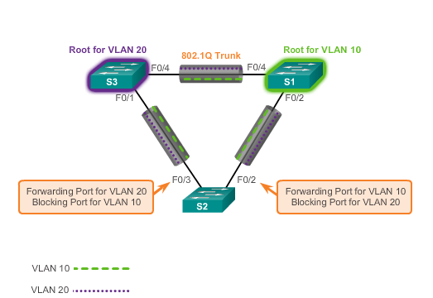
PVST+ Overview of PVST+
Notes:
2.2.2.1 Overview of PVST+

Slide 28
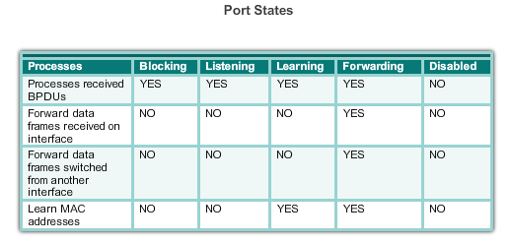
PVST+ Port States and PVST+ Operation
STP introduces the five port states:
Notes:
2.2.2.2 Port States and PVST+ Operation

Slide 29
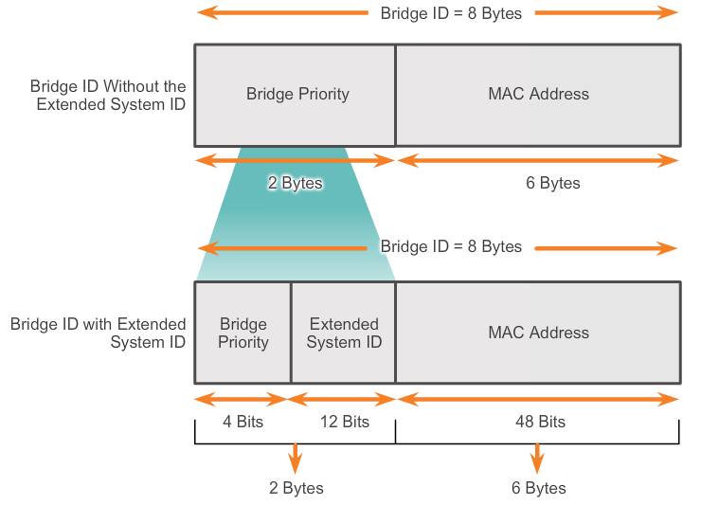
PVST+ Extended System ID and PVST+ Operation
In a PVST+ environment, the extended switch ID ensures each switch has a unique BID for each VLAN.
For example, the VLAN 2 default BID would be 32770; priority 32768, plus the extended system ID of 2.
Notes:
2.2.2.3 Extended System ID and PVST+ Operation

Slide 30
Rapid PVST+ Overview of Rapid PVST+
RSTP is the preferred protocol for preventing Layer 2 loops in a switched network environment.
With Rapid PVST+, an independent instance of RSTP runs for each VLAN.
RSTP supports a new port type: an alternate port in discarding state.
There are no blocking ports. RSTP defines port states as discarding, learning, or forwarding.
RSTP (802.1w) supersedes STP (802.1D) while retaining backward compatibility
RSTP keeps the same BPDU format as IEEE 802.1D, except that the version field is set to 2 to indicate RSTP, and the flags field uses all 8 bits.
Notes:
2.2.3.1 Overview of Rapid PVST+

Slide 31
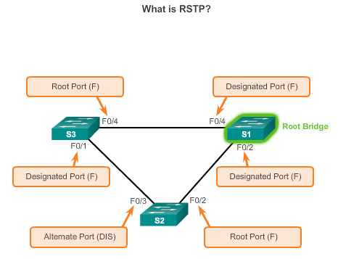
Rapid PVST+ Overview of Rapid PVST+
Notes:
2.2.3.1 Overview of Rapid PVST+

Slide 32
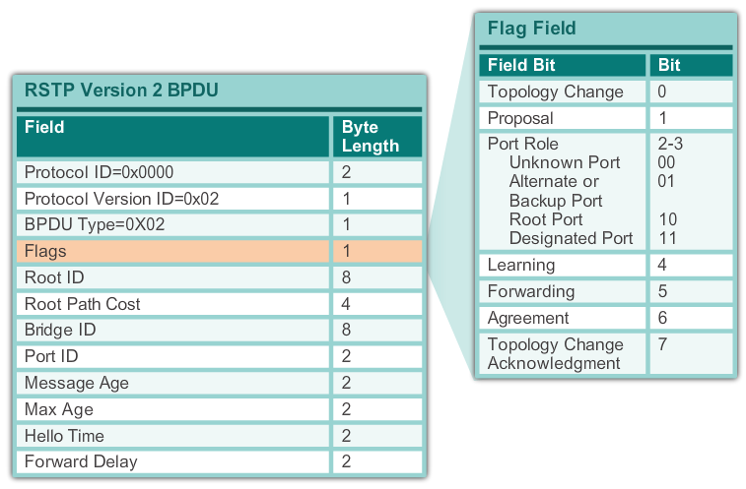
Rapid PVST+ RSTP BPDU
Notes:
2.2.3.2 RSPT BPDU

Slide 33
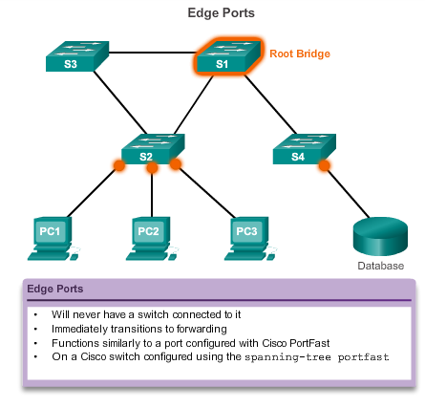
Rapid PVST+ Edge Ports
Notes:
2.2.3.3 Edge Ports

Slide 34
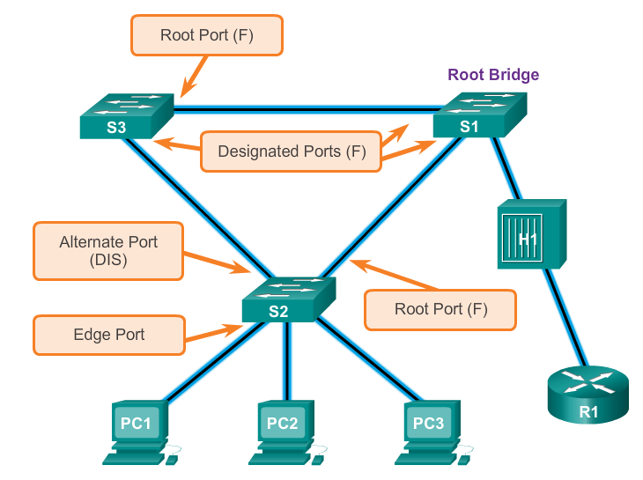
Rapid PVST+ Link Types
The link type can determine whether the port can immediately transition to forwarding state. Edge port connections and point-to-point connections are candidates for rapid transition to forwarding state.
Notes:
2.2.3.4 Link Types

Slide 35
2.3 Spanning Tree Configuration
Notes:
2.3 Spanning Tree Configuration

Slide 36
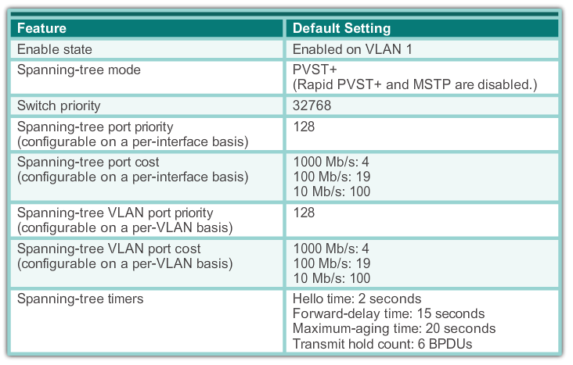
PVST+ Configuration Catalyst 2960 Default Configuration
Notes:
2.3.1.1 Catalyst 2960 Default Configuration

Slide 37
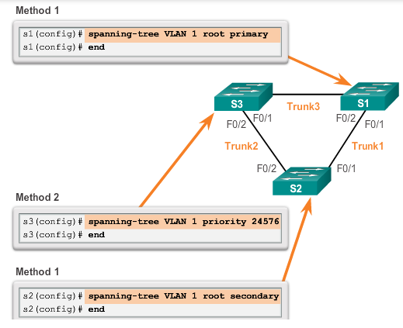
PVST+ Configuration Configuring and Verifying the Bridge ID
Notes:
2.3.1.2 Configuring and Verifying the Bridge ID

Slide 38
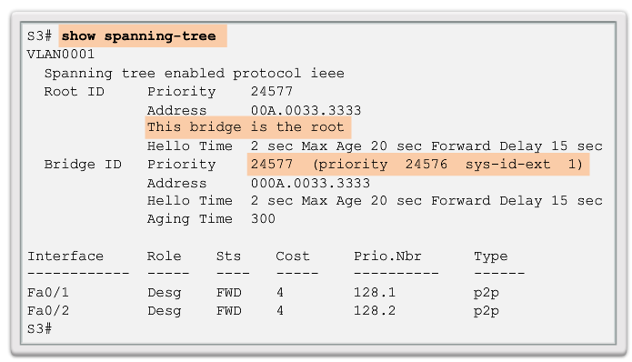
PVST+ Configuration Configuring and Verifying the Bridge ID
Notes:
2.3.1.2 Configuring and Verifying the Bridge ID

Slide 39
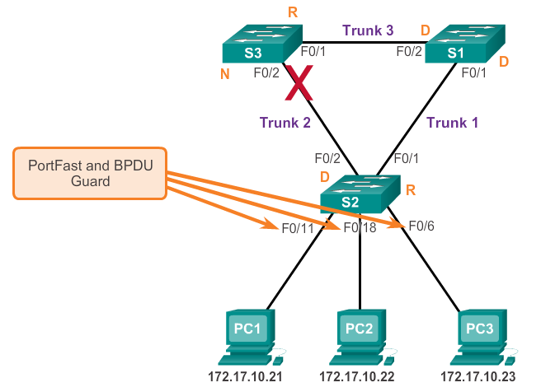
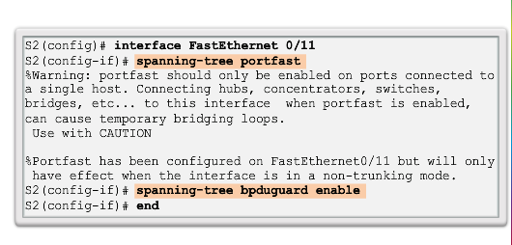
PVST+ Configuration PortFast and BPDU Guard
When a switch port is configured with PortFast that port transitions from blocking to forwarding state immediately.
BPDU guard puts the port in an error-disabled state on receipt of a BPDU.
Notes:
2.3.1.3 PortFast and BPDU Guard

Slide 40
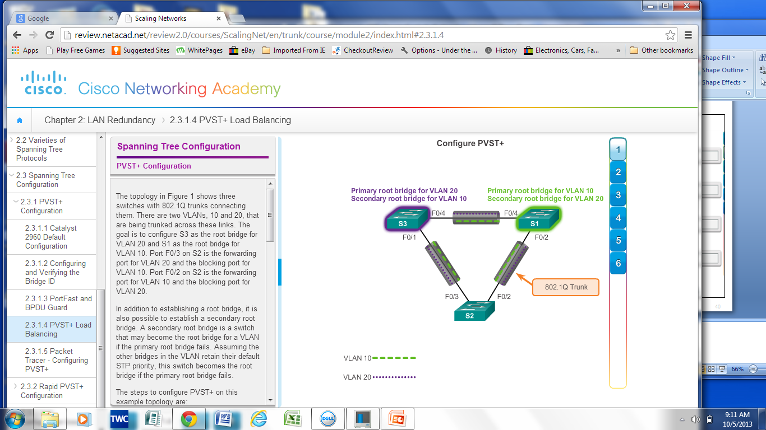
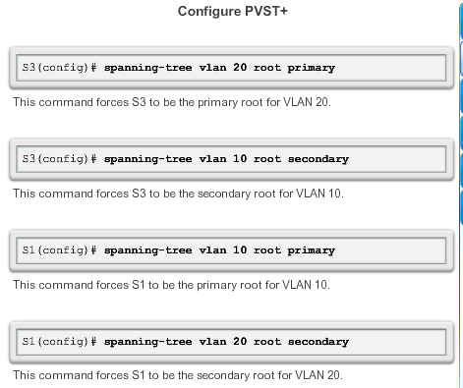
PVST+ Configuration PVST+ Load Balancing
Notes:
2.3.1.4 PVST+ Load Balancing

Slide 41
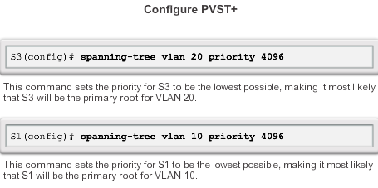
PVST+ Configuration PVST+ Load Balancing
Another method to specify the root bridge is to set the spanning tree priority on each switch to the lowest value so that the switch is selected as the primary bridge for its associated VLAN.
Notes:
2.3.1.4 PVST+ Load Balancing (cont.)

Slide 42
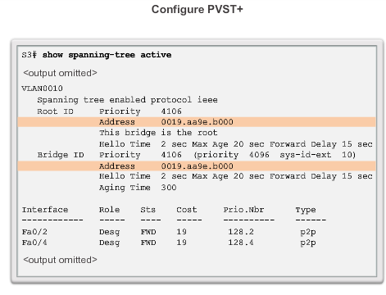
PVST+ Configuration PVST+ Load Balancing
Display and verify spanning tree configuration details.
Notes:
2.3.1.4 PVST+ Load Balancing (cont.)

Slide 43
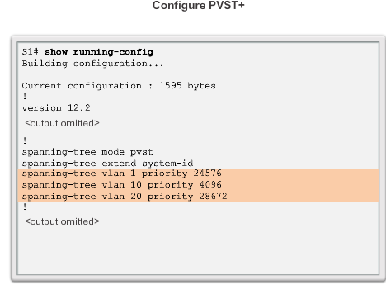
PVST+ Configuration PVST+ Load Balancing
Notes:
2.3.1.4 PVST+ Load Balancing (cont.)

Slide 44
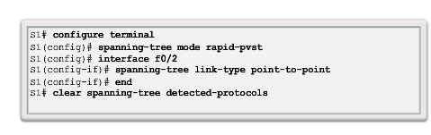
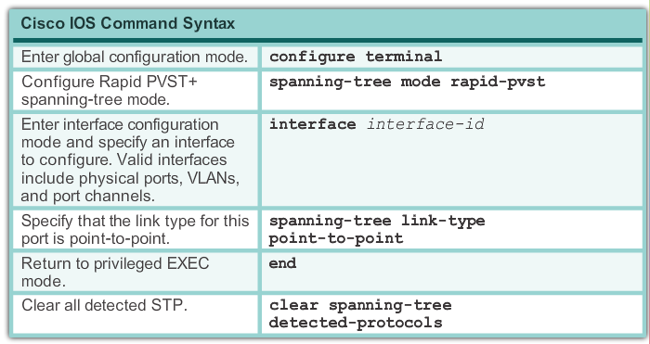
Rapid PVST+ Configuration Spanning Tree Mode
Rapid PVST+ is the Cisco implementation of RSTP. It supports RSTP on a per-VLAN basis.
Notes:
2.3.2.1 Spanning Tree Mode

Slide 45
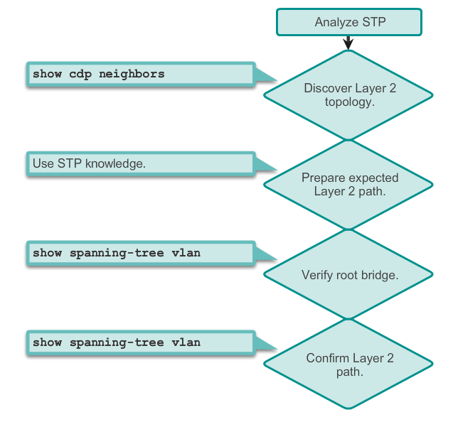
STP Configuration Issues Analyzing the STP Topology
Notes:
2.3.3.1 Analyzing the STP Topology

Slide 46
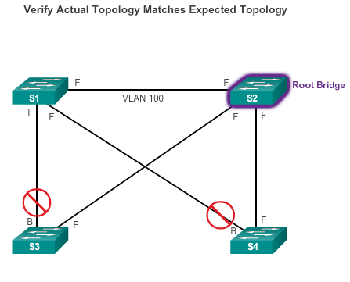
STP Configuration Issues Expected Topology versus Actual Topology
Notes:
2.3.3.2 Expected Topology versus Actual Topology

Slide 47
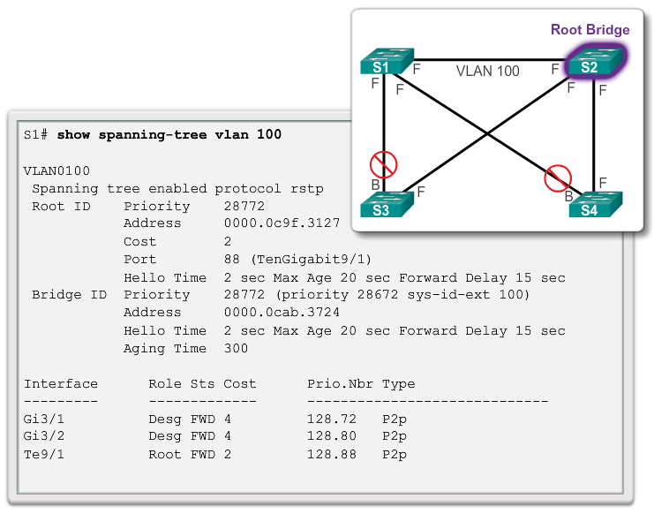
STP Configuration Issues Overview of Spanning Tree Status
Notes:
2.3.3.3 Overview of Spanning Tree Status

Slide 48
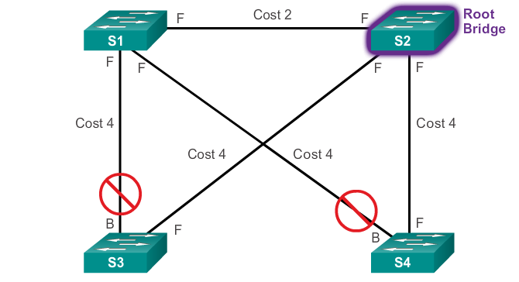
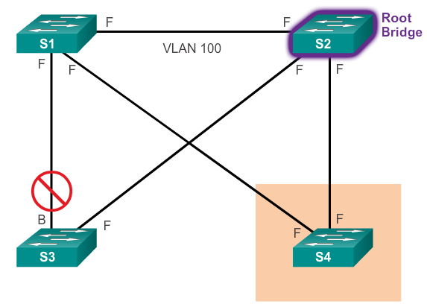
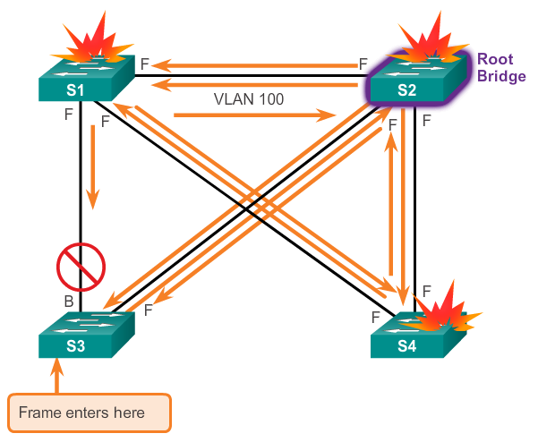
STP Configuration Issues Spanning-Tree Failure Consequences
STP erroneously moves one or more ports into the forwarding state.
Any frame that is flooded by a switch enters the loop.
Notes:
2.3.3.4 Spanning Tree Failure Consequences

Slide 49
STP Configuration Issues Repairing a Spanning Tree Problem
One way to correct spanning-tree failure is to manually remove redundant links in the switched network, either physically or through configuration, until all loops are eliminated from the topology.
Before restoring the redundant links, determine and correct the cause of the spanning-tree failure.
Carefully monitor the network to ensure that the problem is fixed.
Notes:
2.3.3.5 Repairing a Spanning Tree Problem

Slide 50
2.4 First-Hop Redundancy Protocols
Notes:
2.4 First-Hop Redundancy Protocols

Slide 51
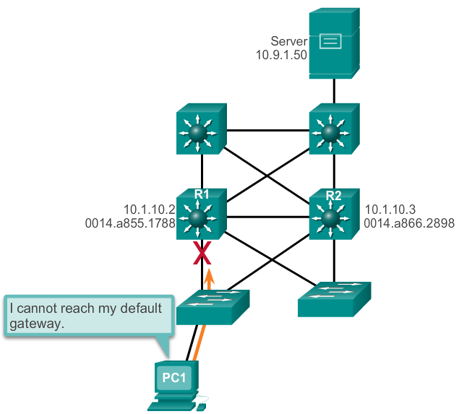
Concept of First-Hop Redundancy Protocols Default Gateway Limitations
If the default gateway cannot be reached, the local device is unable to send packets off the local network segment.
Even if a redundant router exists that could serve as a default gateway for that segment, there is no dynamic method by which these devices can determine the address of a new default gateway.
Notes:
2.4.1.1 Default Gateway Limitations

Slide 52
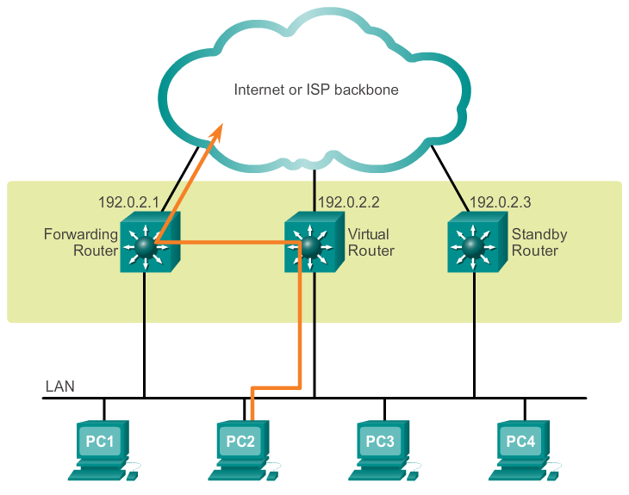
Concept of First-Hop Redundancy Protocols Router Redundancy
Multiple routers are configured to work together to present the illusion of a single router to the hosts on the LAN.
The ability of a network to dynamically recover from the failure of a device acting as a default gateway is known as first-hop redundancy.
Notes:
2.4.1.2 Router Redundancy

Slide 53
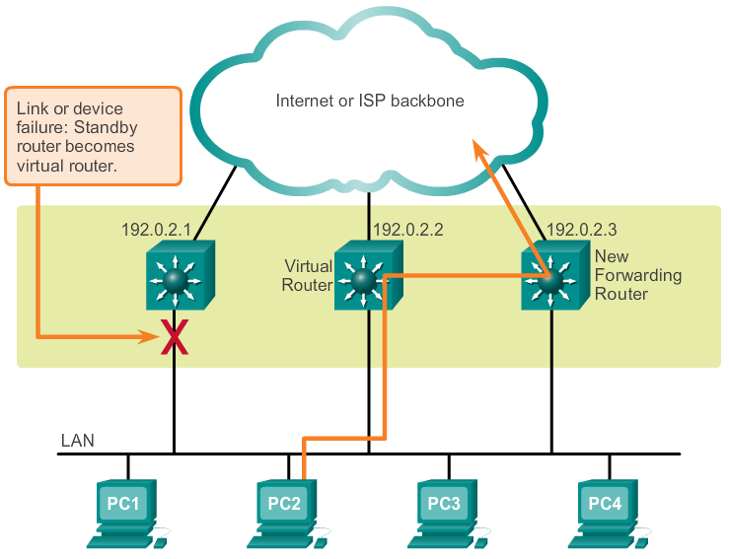
Concept of First-Hop Redundancy Protocols Steps for Router Failover
Notes:
2.4.1.3 Steps for Router Failover

Slide 54
Varieties of First-Hop Redundancy Protocols First-Hop Redundancy Protocols
Hot Standby Router Protocol (HSRP)
HSRP for IPv6
Virtual Router Redundancy Protocol version 2 (VRRPv2)
VRRPv3
Gateway Load Balancing Protocol (GLBP)
GLBP for IPv6
ICMP Router Discovery Protocol (IRDP)
Notes:
2.4.2.1 First-Hop Redundancy Protocols

Slide 55
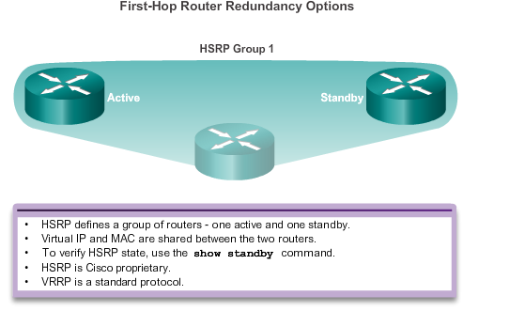
Varieties of First-Hop Redundancy Protocols First-Hop Redundancy Protocols
Notes:
2.4.2.1 First-Hop Redundancy Protocols (cont.)

Slide 56
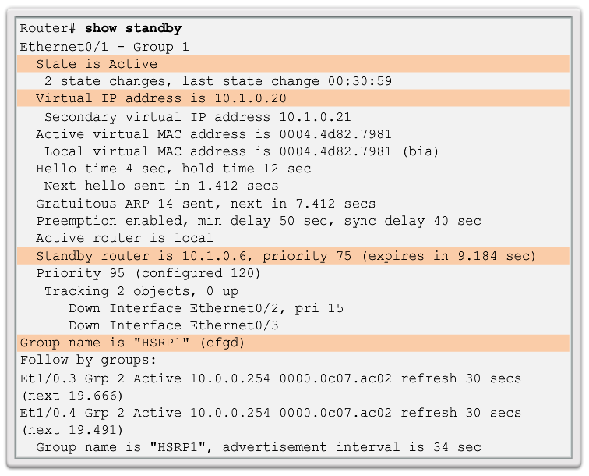
FHRP Verification HSRP Verification
Notes:
2.4.3.1 HSRP Verification

Slide 57
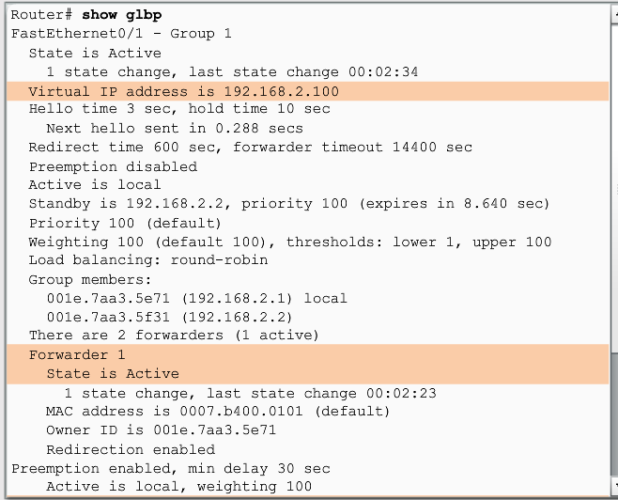
FHRP Verification GLBP Verification
Gateway Load Balancing Protocol (GLBP) is a Cisco proprietary solution to allow automatic selection and simultaneous use of multiple available gateways in addition to automatic failover between those gateways.
Notes:
2.4.3.2 GLBP Verification

Slide 58
2.5 Summary
Notes:
2.5 Summary

Slide 59
Chapter 2: Summary
IEEE 802.1D is implemented on Cisco switches on a per-VLAN basis in the form of PVST+. This is the default configuration on Cisco switches.
RSTP, can be implemented on Cisco switches on a per-VLAN basis in the form of Rapid PVST+.
With PVST+ and Rapid PVST+, root bridges can be configured proactively to enable spanning tree load balancing.
First hop redundancy protocols, such as HSRP, VRRP, and GLBP provide alternate default gateways for hosts in the switched environment.
Notes:
Chapter 2 Summary

Slide 60


